Slide 1
App Review Sentiment Analysis

Slide 2
Team members:
170042001 : Maliha Noushin Raida
170042043: Zannatun Naim Sristy
170042057: Sheikh Moonwara Anjum Monisha
170042081: Nawshin Ulfat

Slide 3
Motivation
App stores provides an option to app users for delivering reviews about the apps. These reviews contains positive, negative or neutral sentiment of the users. For enhancement of the app these users sentiments carry an important means to the developers.
Positive reviews -> Good Performance
Negative reviews -> Bug report, Feature request

Slide 4
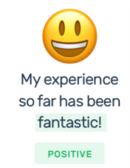
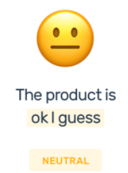
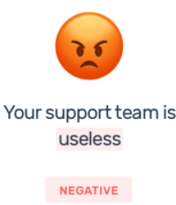
Idea!
Analysis the sentiment (positive/negative/neutral) of app reviews both sentiment classify and using nltk vader.

Slide 5
Data Source
Google Play Store
Apple app store

Slide 6
Language
Python3
Library
Sklearn
Nltk
Matplotlib
Pandas
Numpy
Wordcloud

Slide 7
Methods..
Sentiment Scoring using nltk vader
Sentiment Classification

Slide 8
Sentiment Scoring using nltk vader
Method 1
1
2
3
Lexicon Update
Preprocessing
Sentiment detect
Add most frequent words of this context and respective positive & negative score.
Tokenize
Lemmatize
Assign sentiment status (positive, negative ,neutral) based on score.

Slide 9
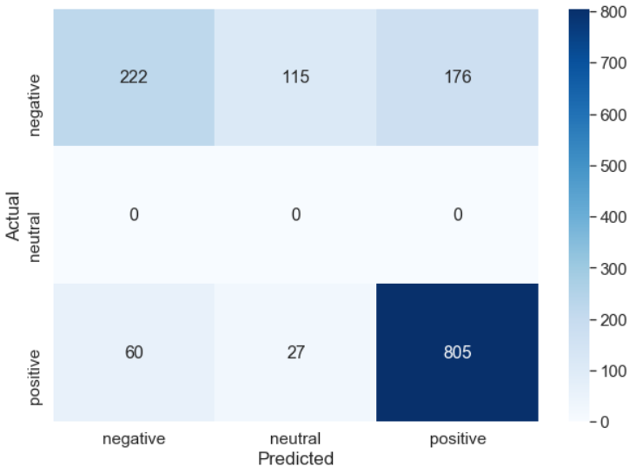
Output
Visualion
Confusion Matrix

Slide 10
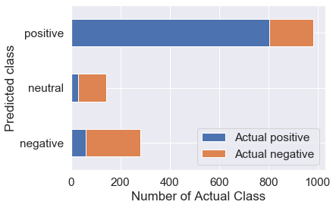
Output
Visualion
Prediction Error

Slide 11
Sentiment Classification
Method 2
1
2
3
4
5
Preprocessing
Tf-Idf
Train test Split
Train Model
Performance
Unnecessary space & character removal.
Lemmatize
Cross validation
Random Forest
Linear SVC
MultinomialNB
Logistic Regression
Accuracy
Recall
Precision
F1-measure
For finding importance of each word

Slide 12
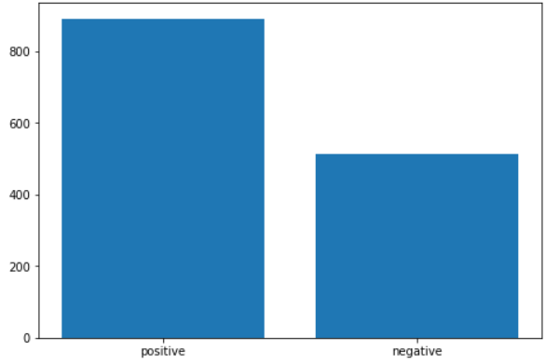
Output
Visualion
Positive Vs Negative Sentiment Frequency

Slide 13
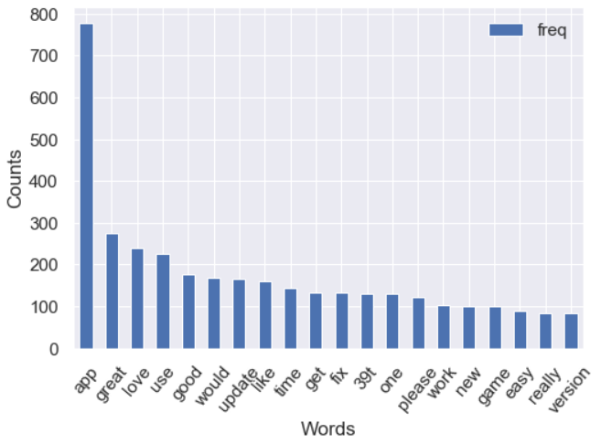
Output
Visualion
Word Frequency

Slide 14
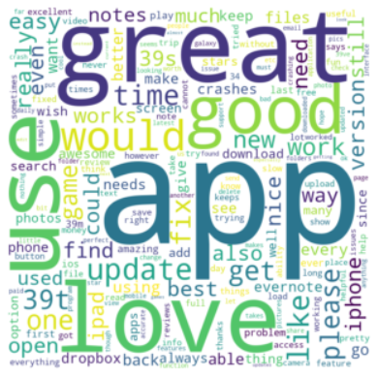
Output
Visualion
Most Important word cloud

Slide 15
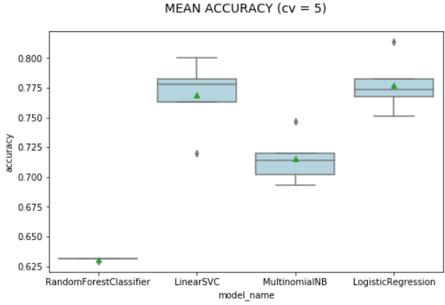
Output
Visualion
Training Model Based Accuracy

Slide 16
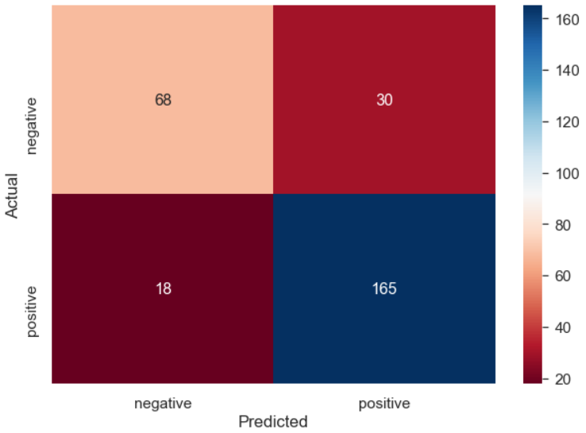
Output
Visualion
Confusion Matrix

Slide 17
Project Demonstration

Slide 18
Challenge
Data set collection
Update lexicon
Explore sentiment classification technique
IDE set up problems for different models

Slide 19
Learnings
Different Processes of sentiment analysis
Different visualization using sentiment analysis results
Sentiment Scoring vs Sentiment Classification

Slide 20
Future Goals
Detect sentiment of different non text data.
Develop the sentiment scoring for neutral reviews.
Detect review types depending on sentiment analysis.

Slide 21
Thanks!

Slide 22
SlidesCarnival icons are editable shapes.
This means that you can:
Resize them without losing quality.
Change fill color and opacity.
Change line color, width and style.
Isn’t that nice? :)
Examples:

Slide 23
Diagrams and infographics

Slide 24
😉
Now you can use any emoji as an icon!
And of course it resizes without losing quality and you can change the color.
How? Follow Google instructions https://twitter.com/googledocs/status/730087240156643328
✋👆👉👍👤👦👧👨👩👪💃🏃💑❤😂😉😋😒😭👶😸🐟🍒🍔💣📌📖🔨🎃🎈🎨🏈🏰🌏🔌🔑 and many more...

Slide 25

Free templates for all your presentation needs
For PowerPoint and Google Slides
100% free for personal or commercial use
Ready to use, professional and customizable
Blow your audience away with attractive visuals

